Slide 1
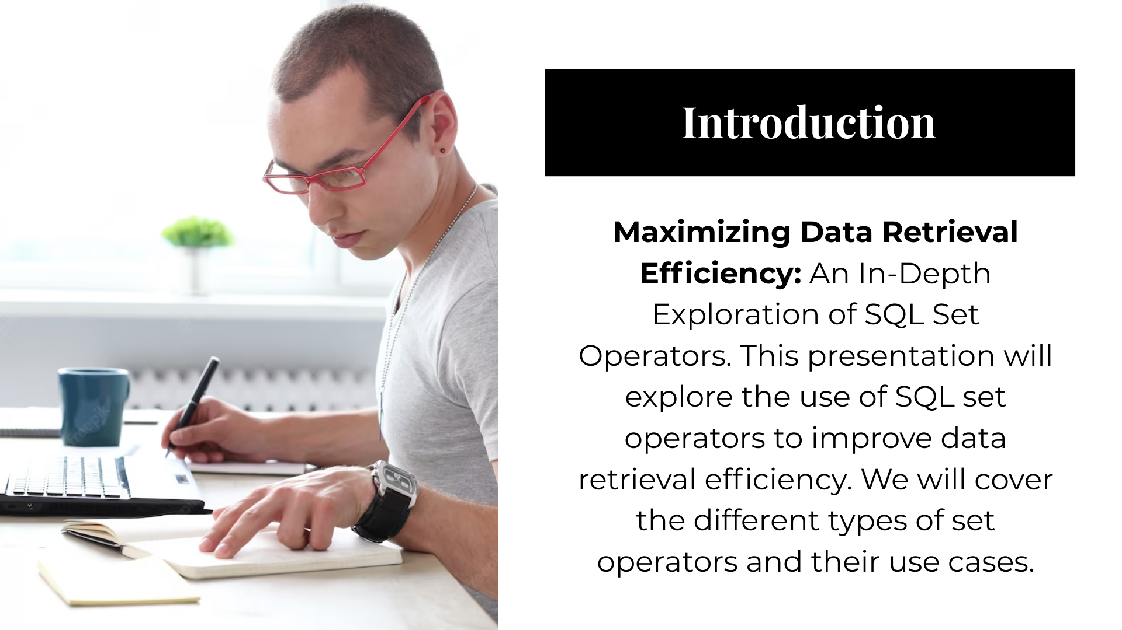
SET OPERATORS

Slide 2
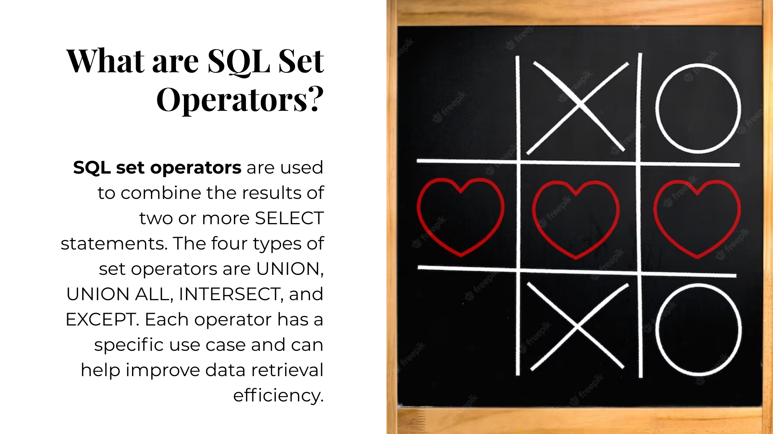
SET OPERATORS

Slide 3
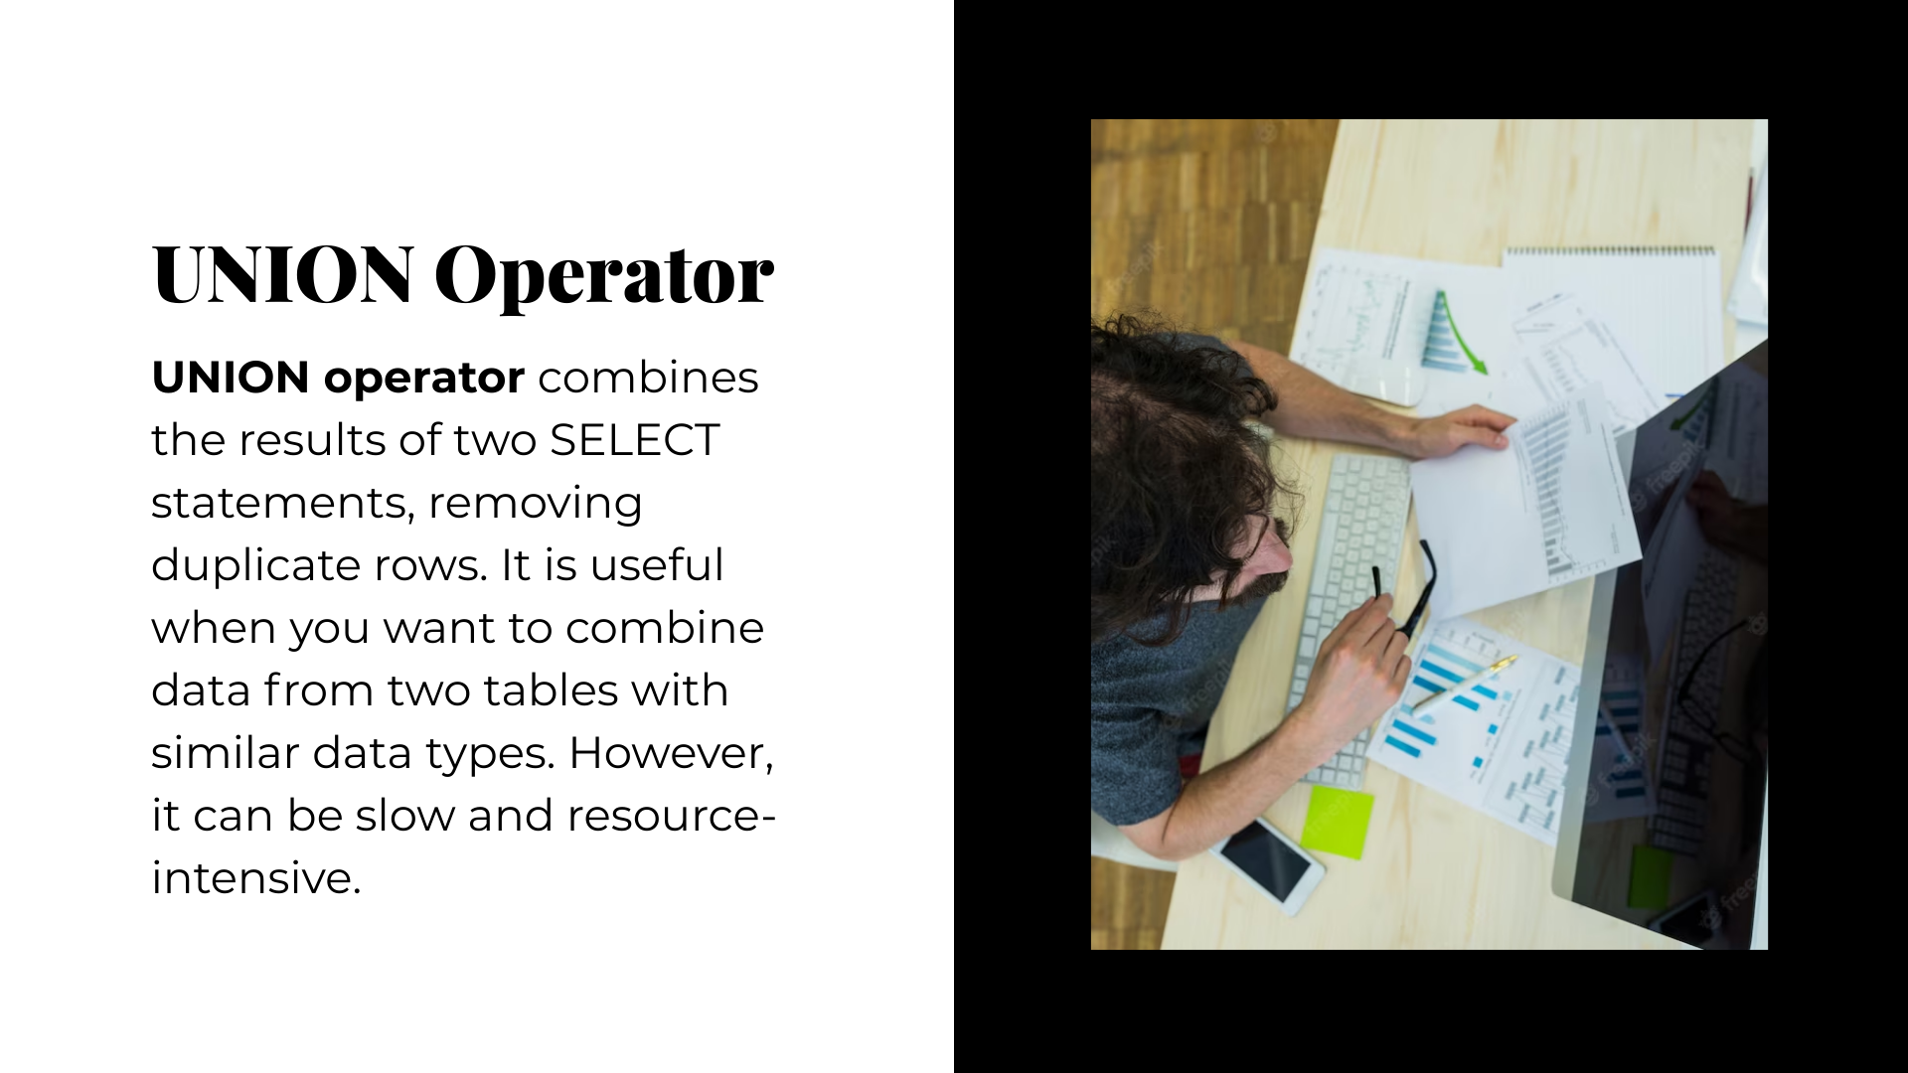
SET OPERATORS -UNION

Slide 4
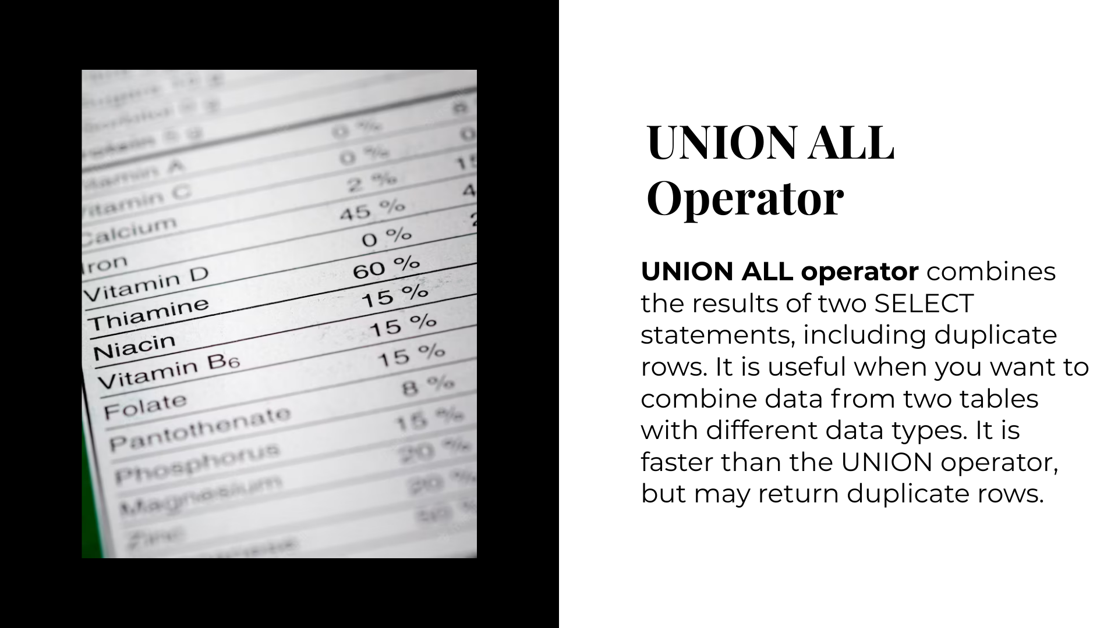
UNION ALL

Slide 5
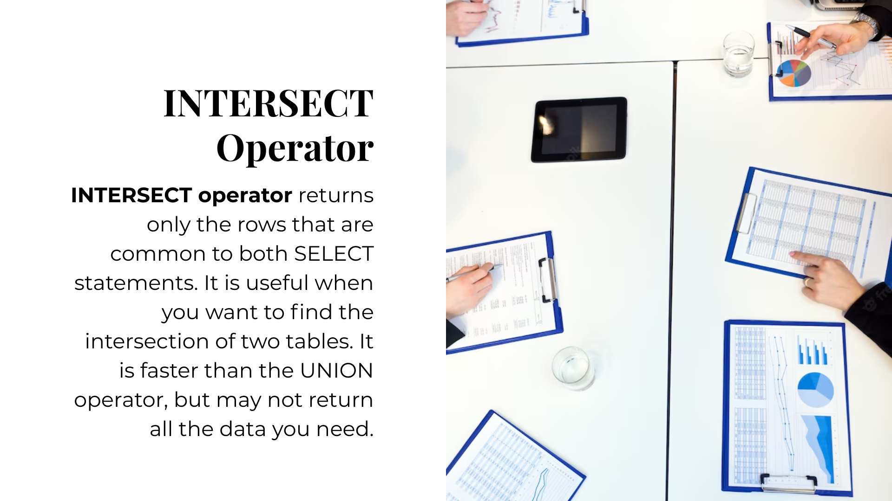
INTERSECT

Slide 6
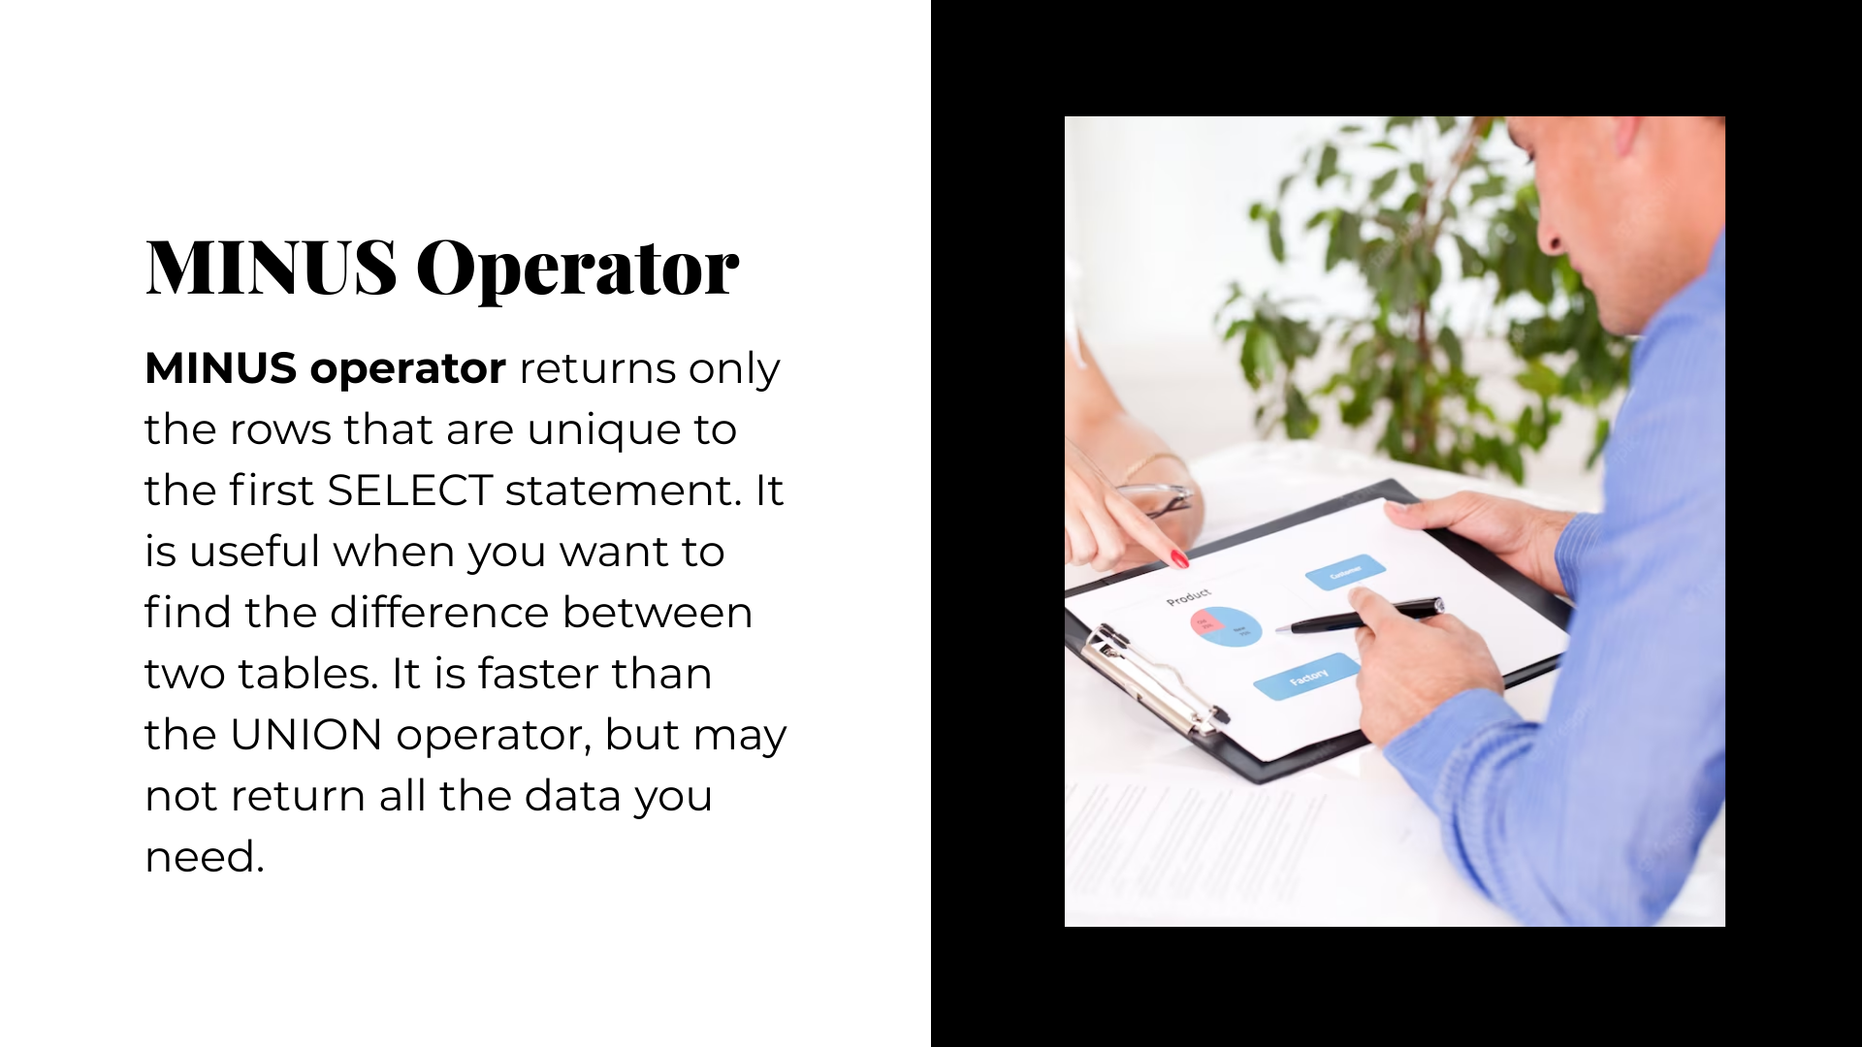
MINUS

Slide 7
EXAMPLE TO EXPLORE
--common job role between IT department and Accounting department---
--intersect---common record
select job_role
from department d inner join emps e
on d.dept_id = e.dept_id inner join job
on job.job_id = e.job_id
where dept_name = 'IT'
intersect
select job_role
from department d inner join emps e
on d.dept_id = e.dept_id inner join job
on job.job_id = e.job_id
where dept_name = 'Accounting'
--uncommon job role between IT department and Accounting department---
select job_role
from department d inner join emps e
on d.dept_id = e.dept_id inner join job
on job.job_id = e.job_id
where dept_name = 'IT'
minus
select job_role
from department d inner join emps e
on d.dept_id = e.dept_id inner join job
on job.job_id = e.job_id
where dept_name = 'Accounting'

Slide 8
EXAMPLE TO EXPLORE
--all job role b/w IT and Accounting department ---union
select job_role
from department d inner join emps e
on d.dept_id = e.dept_id inner join job
on job.job_id = e.job_id
where dept_name = 'Accounting'
union
select job_role
from department d inner join emps e
on d.dept_id = e.dept_id inner join job
on job.job_id = e.job_id
where dept_name = 'IT'
--union all--
select job_role
from department d inner join emps e
on d.dept_id = e.dept_id inner join job
on job.job_id = e.job_id
where dept_name = 'Accounting'
union all
select job_role
from department d inner join emps e
on d.dept_id = e.dept_id inner join job
on job.job_id = e.job_id
where dept_name = 'IT'

